Slide 1
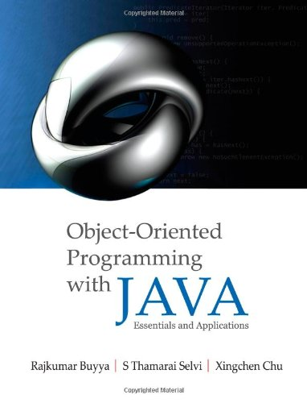
OS Support for Building Distributed Applications:
Multithreaded Programming using Java Threads
Dr. Rajkumar Buyya
Cloud Computing and Distributed Systems (CLOUDS) Laboratory
School of Computing and Information Systems
The University of Melbourne, Australia
http://www.buyya.com

Slide 2
Outline
Introduction to Middleware
Thread Applications
Defining Threads
Java Threads and States
Architecture of Multithreaded servers
Threads Synchronization
Summary

Slide 3
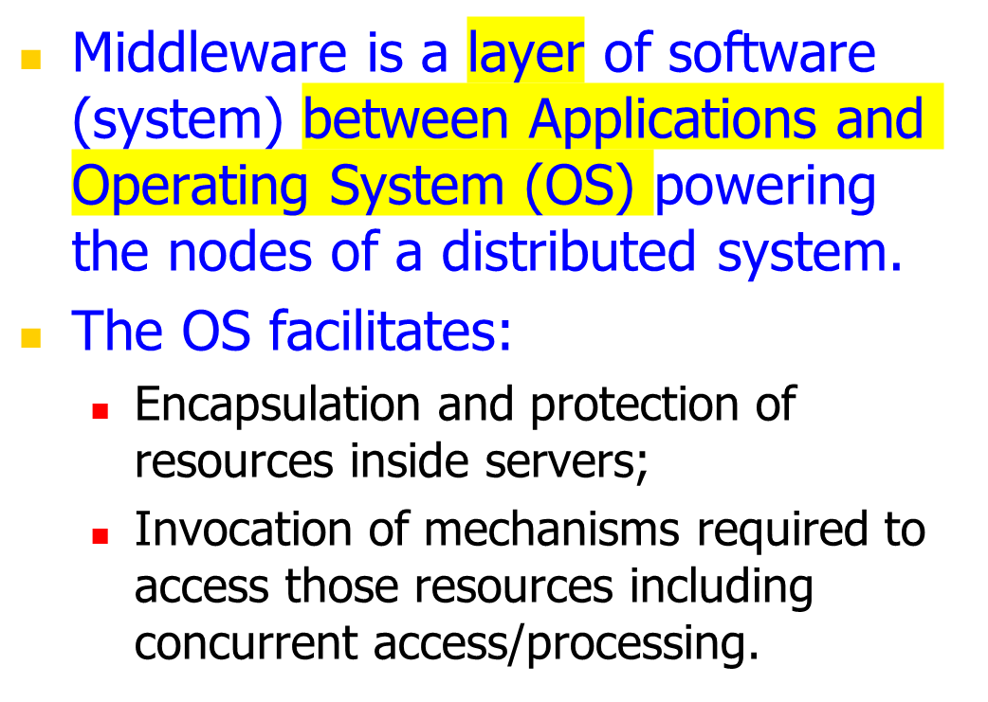
Introduction
Applications
Middleware
Distributed Nodes with OS

Slide 4
Middleware and Network Operating System (NOS)
Many DOS (Distributed OS) have been investigated, but there are none in general/wide use. But NOS are in wide use for various reasons both technical and non-technical.
  Users have much invested in their application software; they will not adopt a new OS that will not run their applications.
  Users tend to prefer to have a degree of autonomy of their machines, even in a closely knit organisation.
A combination of middleware and NOSs provides an acceptable balance between the requirement of autonomy and network transparency.
  NOS allows users to run their favorite word processor.
  Middleware enables users to take advantage of services that become available in their distributed systems.

Slide 5






Introducing a middleware
Building Distributed Systems
  DOS or NOS are not enough to build a DS!
  NOS are a good starting point but ….
  … we need an additional layer “gluing” all together
Middleware
NOS
Notes:
You can decide the best networking protocol to use (e.g. TCP/UDP), the best and most efficient message format, and how to optimally store the dictionary for fast lookups.

Slide 6
Building Distributed Systems
Middleware
  High-level features for DS
    Communication
    Management
    Application specific
  Uniform layer where to build DS services
  Runtime environment of applications
Operating System
  Low / medium level (core) features
    Process / threads management
    Local hardware (CPU, disk, memory)
    Security (users, groups, domain, ACLs)
    Basic networking

Slide 7
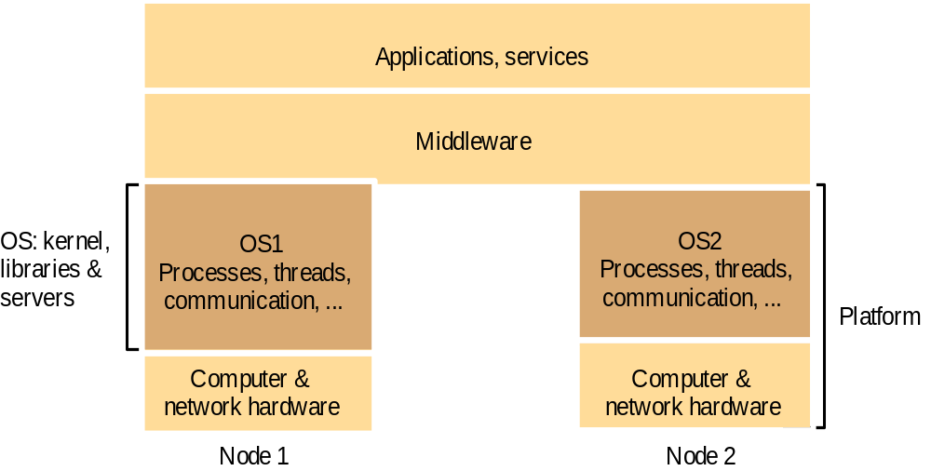
Operating system layers and Middleware
Unix and Windows are two examples of Network Operating Systems – have a networking capability built into them and so can be used to access remote resources using basic services such as rlogin, telnet.

Slide 8
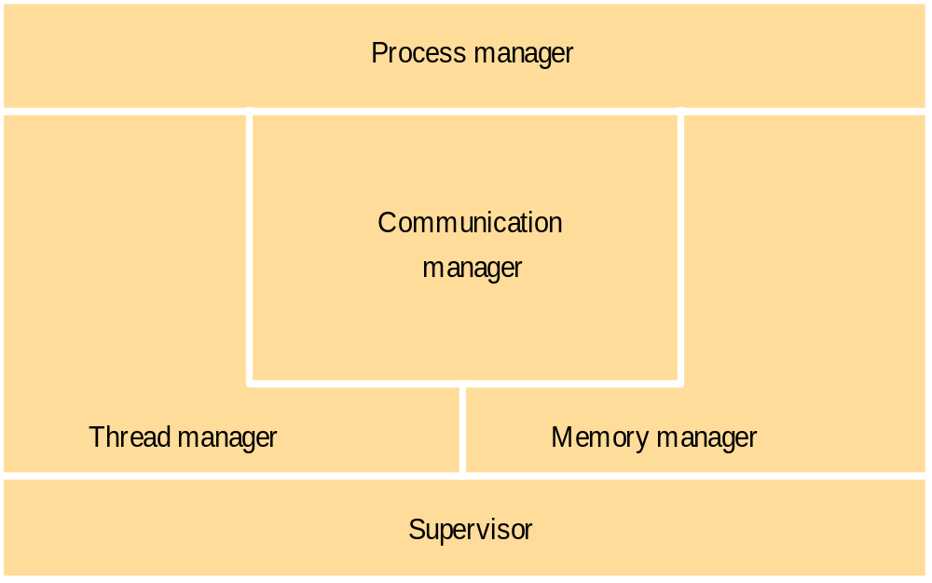
Core OS components and functionality

Slide 9
Threaded Applications
Modern Applications and Systems
  Operating System Level
    Multitasking: multiple applications running at once
  Application Level
    Multithreading: multiple operations performed at the same time within an application.
  Bottom Line:
    Illusion of concurrency
Notes:
Upon completion, a graduate of the program should have:
*expertise in Internet programming and distributed computing,
*be able to apply acquired techniques and knowledge to contribute to the development and implementation of enterprise software systems,
*be able to analyse and design ICT projects and future ICT needs, and
*be able to apply Internet-based distributed computing systems and algorithms to e-Science and e-Business applications.

Slide 10










Threaded Applications
Modern Systems
  Multiple applications run concurrently!
  This means that… there are multiple processes on your computer
games
web & email
office automation
multimedia
pictures
Multitasking
Notes:
GRIDS Lab is located ….

Slide 11
A single threaded program
class ABC
{
….
  public void main(..)
  {
  …
  ..
  }
}
begin
body
end

Slide 12





Threaded Applications
Modern Systems
  Applications perform many tasks at once!
  This means that… there are multiple threads within a single process.
Background printing
GUI rendering
Application core logic

Slide 13

A Multithreaded Program
Main Thread
start
start
start
Thread A
Thread B
Thread C

Slide 14
Single and Multithreaded Processes
Single-threaded Process
Multi-threaded Process
Threads of
Execution
Single instruction stream
Multiple instruction stream
Common
Address Space

Slide 15




Multithreaded Server: For Serving Multiple Clients Concurrently
Modern Applications
  Example: Multithreaded Web Server
Process Request Client 1
Web/FTP
server
Process Request Client 2
Client 1
Process Request Client N
Client 2
Client N

Slide 16

Threaded Applications
Modern Applications
  Example: Internet Browser + Youtube
Video Streaming
Favorities, Share,
Comments Posting

Slide 17
Modern Applications need Threads (ex1):
Editing and Printing documents in background.
Printing Thread
Editing Thread

Slide 18

Multithreaded/Parallel File Copy
reader()
{
  - - - - - - - - - -
  lock(buff[i]);
  read(src,buff[i]);
  unlock(buff[i]);
  - - - - - - - - - -
}
writer()
{
  - - - - - - - - - -
  lock(buff[i]);
  write(src,buff[i]);
  unlock(buff[i]);
  - - - - - - - - - -
}
buff[0]
buff[1]
Cooperative Parallel Synchronized Threads

Slide 19
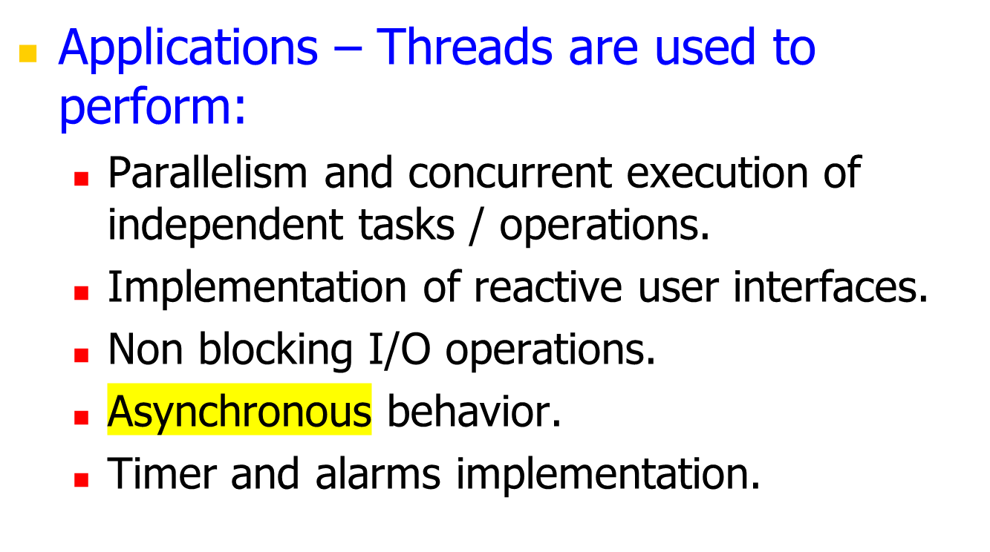
Defining Threads

Slide 20
Defining Threads
Example: Web/FTP Server
Main Thread
while <running>
{
<wait for request>
<create a new worker thread>
<start the thread>
}
<request 1>
Web/FTP
server
Execution Timeline
Worker
Thread
<request 2>
<request N>
Worker
Thread
Worker
Thread

Slide 21
Defining Threads
A Thread is a piece of code that runs in concurrent with other threads.
Each thread is a statically ordered sequence of instructions.
Threads are used to express concurrency on both single and multiprocessors machines.
Programming a task having multiple threads of control is called: Multithreading or Multithreaded Programming.

Slide 22
Java Threads
Java has built in support for Multithreading
Synchronization
Thread Scheduling
Inter-Thread Communication:
  currentThread start setPriority
  yield run getPriority
  sleep stop suspend
  resume
Java Garbage Collector is a low-priority thread.

Slide 23
Threading Mechanisms...
Create a class that extends the Thread class
Create a class that implements the Runnable interface
Thread
Runnable
Thread
MyThread
MyClass
(objects are threads)
(objects with run() body)
[a]
[b]

Slide 24
1st method: Extending Thread class
Create a class by extending Thread class and override run() method:
class MyThread extends Thread
{
public void run()
{
// thread body of execution
}
}
Create a thread:
MyThread thr1 = new MyThread();
Start Execution of threads:
thr1.start();
Create and Execute:
new MyThread().start();

Slide 25
An example
class MyThread extends Thread {
public void run() {
System.out.println(" this thread is running ... ");
}
}
class ThreadEx1 {
public static void main(String [] args ) {
MyThread t = new MyThread();
t.start();
}
}

Slide 26
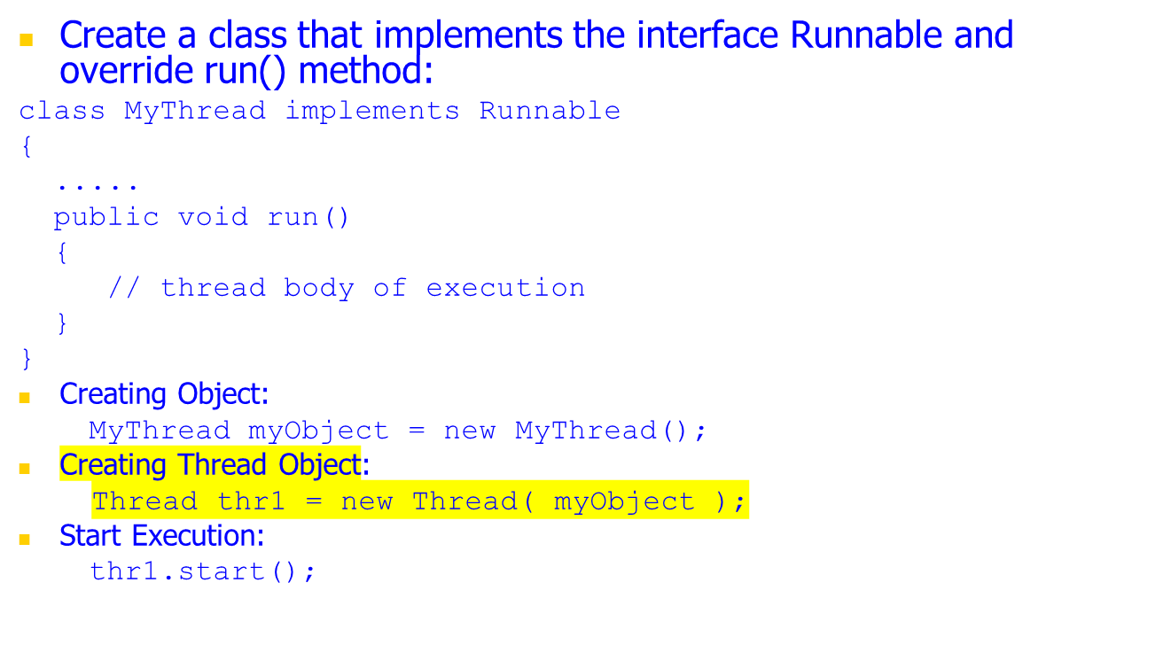
2nd method: Threads by implementing Runnable interface

Slide 27
An example
class MyThread implements Runnable {
public void run() {
System.out.println(" this thread is running ... ");
}
}
class ThreadEx2 {
public static void main(String [] args ) {
Thread t = new Thread(new MyThread());
t.start();
}
}

Slide 28
Life Cycle of Thread
new
start()
I/O completed
ready
resume()
Time expired/
interrupted
notify()
sleeping
blocked
waiting
dispatch
sleep()
wait()
suspend()
running
Block on I/O
completion
stop()
dead

Slide 29
A Program with Three Java Threads
Write a program that creates 3 threads

Slide 30
Three threads example
class A extends Thread
{
public void run()
{
for(int i=1;i<=5;i++)
{
System.out.println("\t From ThreadA: i= "+i);
}
System.out.println("Exit from A");
}
}
class B extends Thread
{
public void run()
{
for(int j=1;j<=5;j++)
{
System.out.println("\t From ThreadB: j= "+j);
}
System.out.println("Exit from B");
}
}

Slide 31
Three threads example
class C extends Thread
{
public void run()
{
for(int k=1;k<=5;k++)
{
System.out.println("\t From ThreadC: k= "+k);
}
System.out.println("Exit from C");
}
}
class ThreadTest
{
public static void main(String args[])
{
new A().start();
new B().start();
new C().start();
}
}

Slide 32
Run 1
[raj@mundroo] threads [1:76] java ThreadTest
From ThreadA: i= 1
From ThreadA: i= 2
From ThreadA: i= 3
From ThreadA: i= 4
From ThreadA: i= 5
Exit from A
From ThreadC: k= 1
From ThreadC: k= 2
From ThreadC: k= 3
From ThreadC: k= 4
From ThreadC: k= 5
Exit from C
From ThreadB: j= 1
From ThreadB: j= 2
From ThreadB: j= 3
From ThreadB: j= 4
From ThreadB: j= 5
Exit from B

Slide 33
Run 2
[raj@mundroo] threads [1:77] java ThreadTest
From ThreadA: i= 1
From ThreadA: i= 2
From ThreadA: i= 3
From ThreadA: i= 4
From ThreadA: i= 5
From ThreadC: k= 1
From ThreadC: k= 2
From ThreadC: k= 3
From ThreadC: k= 4
From ThreadC: k= 5
Exit from C
From ThreadB: j= 1
From ThreadB: j= 2
From ThreadB: j= 3
From ThreadB: j= 4
From ThreadB: j= 5
Exit from B
Exit from A

Slide 34
Thread Priority
In Java, each thread is assigned priority, which affects the order in which it is scheduled for running. The threads so far had same default priority (NORM_PRIORITY) and they are served using FCFS policy.
  Java allows users to change priority:
    ThreadName.setPriority(intNumber)
      MIN_PRIORITY = 1
      NORM_PRIORITY=5
      MAX_PRIORITY=10

Slide 35
Thread Priority Example
class A extends Thread
{
public void run()
{
System.out.println("Thread A started");
for(int i=1;i<=4;i++)
{
System.out.println("\t From ThreadA: i= "+i);
}
System.out.println("Exit from A");
}
}
class B extends Thread
{
public void run()
{
System.out.println("Thread B started");
for(int j=1;j<=4;j++)
{
System.out.println("\t From ThreadB: j= "+j);
}
System.out.println("Exit from B");
}
}

Slide 36
Thread Priority Example
class C extends Thread
{
public void run()
{
System.out.println("Thread C started");
for(int k=1;k<=4;k++)
{
System.out.println("\t From ThreadC: k= "+k);
}
System.out.println("Exit from C");
}
}
class ThreadPriority
{
public static void main(String args[])
{
A threadA=new A();
B threadB=new B();
C threadC=new C();
threadC.setPriority(Thread.MAX_PRIORITY);
threadB.setPriority(threadA.getPriority()+1);
threadA.setPriority(Thread.MIN_PRIORITY);
System.out.println("Started Thread A");
threadA.start();
System.out.println("Started Thread B");
threadB.start();
System.out.println("Started Thread C");
threadC.start();
System.out.println("End of main thread");
}
}

Slide 37
Assignment 1 at a Glance: Multithreaded Dictionary Server – Using Sockets and Threads
Multithreaded
Dictionary Server
A Client Program
Meaning(“guru”)?
Meaning (“guru”)
“master or teacher”
A Client Program
Meaning(“love”)?
A Client
Program in “C”
Meaning(“java”)?
A Client
Program in “C++”
Meaning(“channel”)?

Slide 38
Use of Sockets in Assignment 1:
A Suggestion
First time:
  Use TCP Sockets
Prior background in TCP Sockets:
  Use UDP Sockets
Full details –released as part of:
  “Assignment 1 Guideline” Report

Slide 39
Accessing Shared Resources
Applications access to shared resources need to be coordinated.
  Printer (two person jobs cannot be printed at the same time)
  Simultaneous operations on your bank account.
  Can the following operations be done at the same time on the same account?
    Deposit()
    Withdraw()
    Enquire()

Slide 40
Online Bank: Serving Many Customers and Operations
Internet
Bank Server
Client 1
Bank Operator 1
Bank Local Area Network
Client 2
Bank Operator M
Client N
Bank Database

Slide 41
Shared Resources
If one thread tries to read the data and other thread tries to update the same data, it leads to inconsistent state.
This can be prevented by synchronising access to the data.
Use “synchronized” method:
  public synchronized void update()
  {
    …
  }

Slide 42
the driver: 3 Threads sharing the same object
class InternetBankingSystem {
public static void main(String [] args ) {
Account accountObject = new Account ();
Thread t1 = new Thread(new MyThread(accountObject));
Thread t2 = new Thread(new YourThread(accountObject));
Thread t3 = new Thread(new HerThread(accountObject));
t1.start();
t2.start();
t3.start();
// DO some other operation
} // end main()
}

Slide 43
Shared account object between 3 threads
class MyThread implements Runnable {
Account account;
public MyThread (Account s) { account = s;}
public void run() { account.deposit(); }
} // end class MyThread
class YourThread implements Runnable {
Account account;
public YourThread (Account s) { account = s;}
public void run() { account.withdraw(); }
} // end class YourThread
class HerThread implements Runnable {
Account account;
public HerThread (Account s) { account = s; }
public void run() {account.enquire(); }
} // end class HerThread
account
(shared object)

Slide 44
Monitor (shared object access): serializes operation on shared objects
class Account { // the 'monitor'
int balance;
  // if 'synchronized' is removed, the outcome is unpredictable
  public synchronized void deposit( ) {
  // METHOD BODY : balance += deposit_amount;
  }
  public synchronized void withdraw( ) {
  // METHOD BODY: balance -= deposit_amount;
  }
  public synchronized void enquire( ) {
  // METHOD BODY: display balance.
  }
}

Slide 45
Architecture for Multithread Servers
Multithreading enables servers to maximize their throughput, measured as the number of requests processed per second.
Threads may need to treat requests with varying priorities:
  A corporate server could prioritize request processing according to class of customers.
Architectures:
  Worker pool
  Thread-per-request
  Thread-per-connection
  Thread-per-object

Slide 46
Client and server with threads
(worker-pool architecture)
Thread 2 makes
requests to server
Input-output
Receipt &
queuing
Thread 1
generates
results
T1
Requests
N threads
Client
Server
In worker-pool architectures, the server creates a fixed pool of worker threads to process requests.
The module “receipt and queuing” receives requests from sockets/ports and places them on a shared request queue for retrieval by the workers.

Slide 47
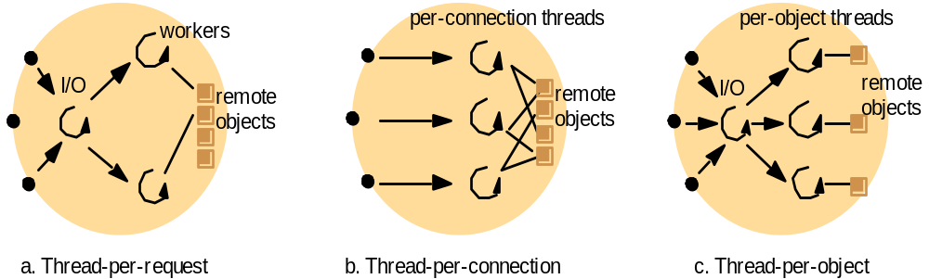
Alternative server threading architectures
Server associates a Thread with each connection and destroys when client closes the connection.
Client may make many requests over the connection.
Associates Thread with each object. An IO thread receives request and queues them for workers, but this time there is a per-object queue.
IO Thread creates a new worker thread for each request and worker thread destroys itself after serving the request.

Slide 48
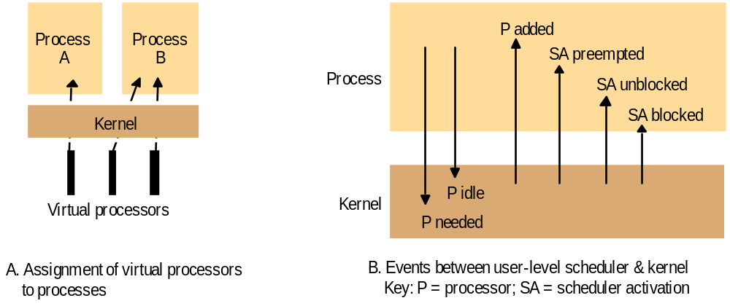
Scheduler activations

Slide 49
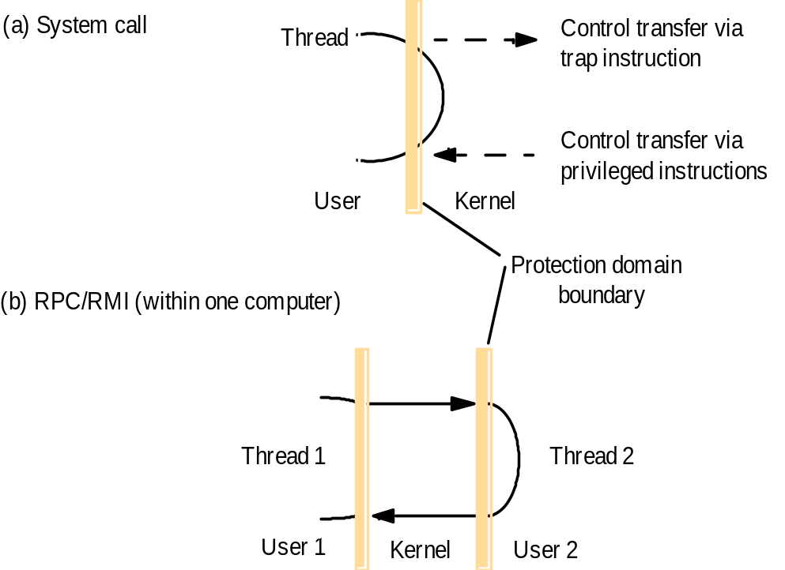
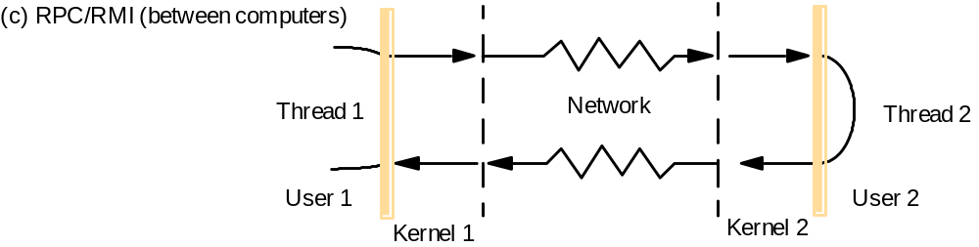
Invocations between address spaces

Slide 50
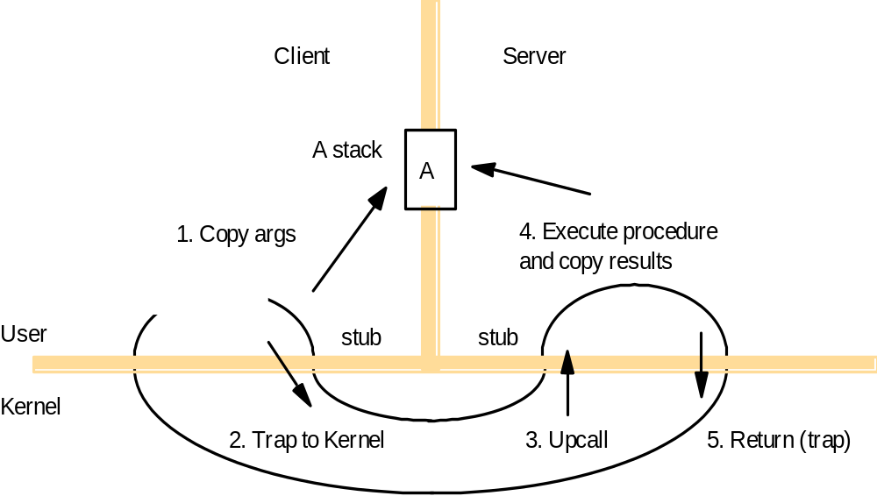
A lightweight remote procedure call

Slide 51
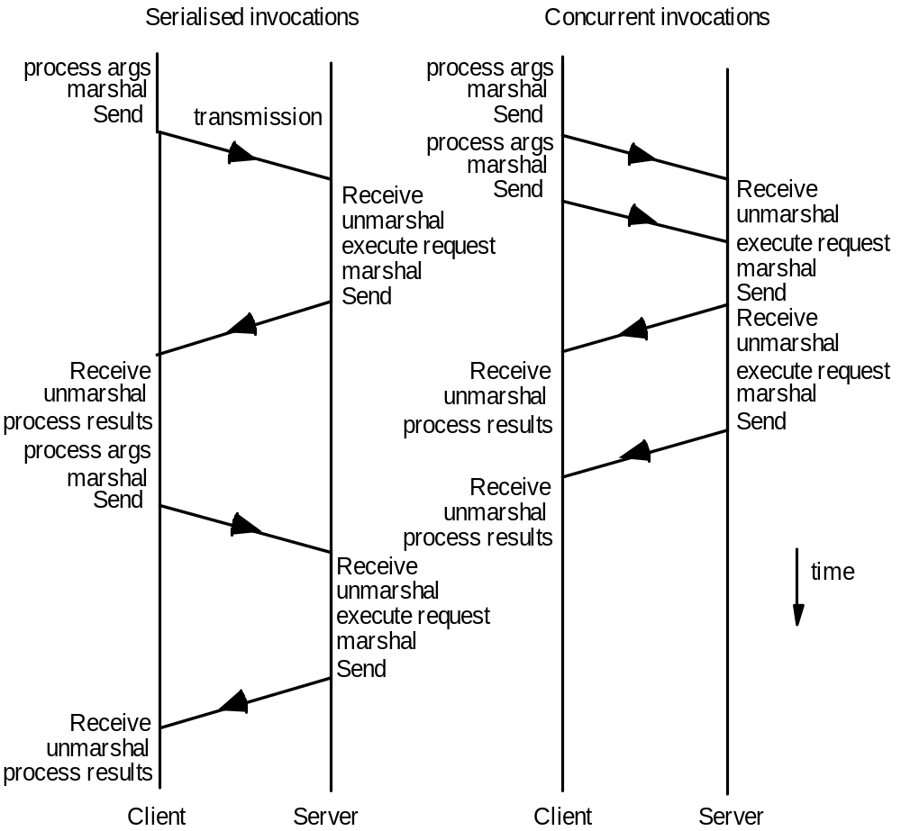
Times for serialized and concurrent invocations

Slide 52
Summary
Operating system provides various types of facilities to support middleware for distributed system:
  encapsulation, protection, and concurrent access and management of node resources.
Multithreading enables servers to maximize their throughput, measured as the number of requests processed per second.
Threads support treating of requests with varying priorities.
Various types of architectures can be used in concurrent processing:
  Worker pool
  Thread-per-request
  Thread-per-connection
  Thread-per-object
Threads need to be synchronized when accessing and manipulating shared resources.
New OS designs provide flexibility in terms of separating mechanisms from policies.

Slide 53
References
CDK Book (Text Book)
  Chapter 7 – “Operating System Support”
Chapter 14: Multithread Programming
  R. Buyya, S. Selvi, X. Chu, “Object Oriented Programming with Java: Essentials and Applications”, McGraw Hill, New Delhi, India, 2009.

